Slide 1
MOR based Fast Frequency Sweep for FELIS
Frederik Quetscher, Erion Gjonaj

Slide 2
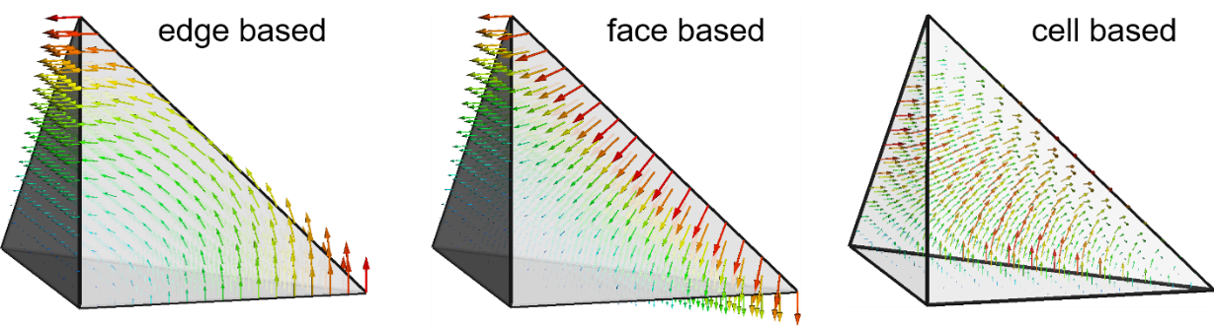
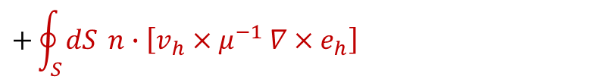
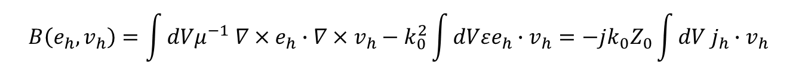

The FELIS Code
The frequency domain problem
Discretization with high order FE: find$e_{h}∈H(curl)$ such that:
$$∇×μ^{−1}∇×E−k_{0}^{2}εE=−jk_{0}Z_{0}J_{s } { J}_{s}\left(x,y,z,ω\right)=v_{p}δ\left(x−x_{0}\right)δ\left(y−y_{0}\right)e^{−i\frac{ω}{v}z}$$
$$B\left(e_{h},v_{h}\right)=\int{dVμ^{−1} ∇×e_{h}∙∇×v_{h}}−k_{0}^{2}\int{dVεe_{h}∙v_{h}}=−jk_{0}Z_{0}\int{dV j_{h}∙v_{h} }$$
$$+\oint_{S}^{ }{dS }n∙\left[v_{h}×μ^{−1} ∇×e_{h}\right]$$
boundary term

Slide 3

The FELIS Code
Full weak formulation including boundary conditions
$$\int{dVμ^{−1} ∇×e_{h}∙∇×v_{h}}−k_{0}^{2}\int{dVε{ e}_{h}∙v_{h}}=−jk_{0}Z_{0}\int{dV{ j}_{h}∙v_{h} }−$$
$$\sum_{m}{P_{m}^{TE}\left(e_{h}\right)}+\sum_{m}{P_{m}^{TM}\left(e_{h}\right)}+$$
$$\int_{S_{SIBC}}^{ }{dS n∙\left[v_{h}×μ^{−1} ∇×E\right]}+$$
$$\oint_{S_{WG}}^{ }{dS }n∙\left[v_{h}×μ^{−1} ∇×E^{inc}\right]+$$
$$\sum_{m}{U_{m}^{TE}}+\sum_{m}{U_{m}^{TM}}$$
Port operators
Beam current
Resistive walls (SIBC)
Incoming beam field at the ports
Reflected beam field at the ports

Slide 4
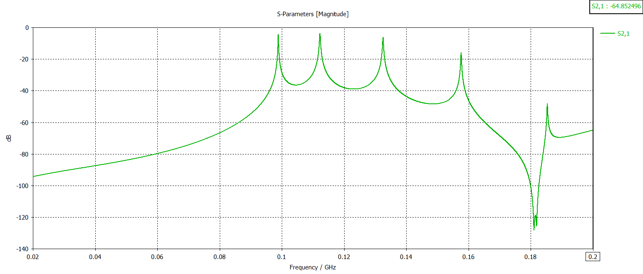
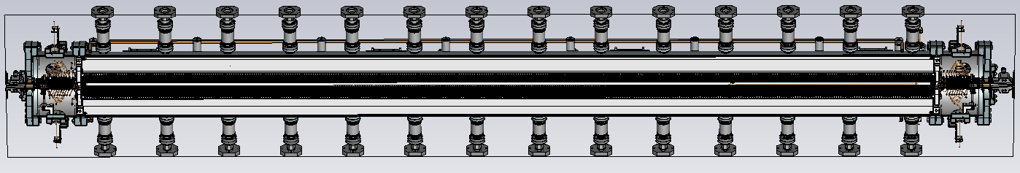
Problem Description
Direct approach for frequency sweep: solve problem in every relevant frequency
Large number of resonances in spectrum
Position and number is a priori unknown
> Large number of model evaluations necessary (expensive)

Slide 5
Fast Frequency Sweep
Idea: Solve the problem in some frequencies and cheaply obtain the remaining ones
Aproaches
Rational interpolation of S-parameters (e.g. in CST)
Vector fitting
AAA
AWE, WCAWE
Rational ‚tailor series‘ expansions of the weak formulation
MOR
Low dimensional solution space for the weak formulation (projection)
…

Slide 6
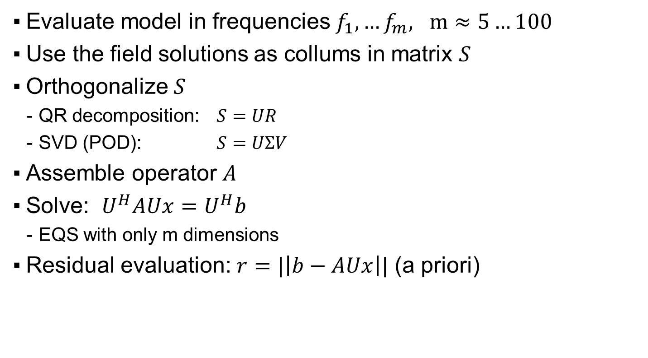
MOR overview (RBM)
Evaluate model in frequencies $f_{1},…f_{m}, m≈5…100$
Use the field solutions as collums in matrix $S$
Orthogonalize $S$
QR decomposition: $S=UR$
SVD (POD): $S=UΣV$
Assemble operator $A$
Solve: $U^{H}AUx=U^{H}b$
EQS with only m dimensions
Residual evaluation: $r=|\left|b−AUx\right||$ (a priori)
Notes:
RBM begriff recherchieren

Slide 7
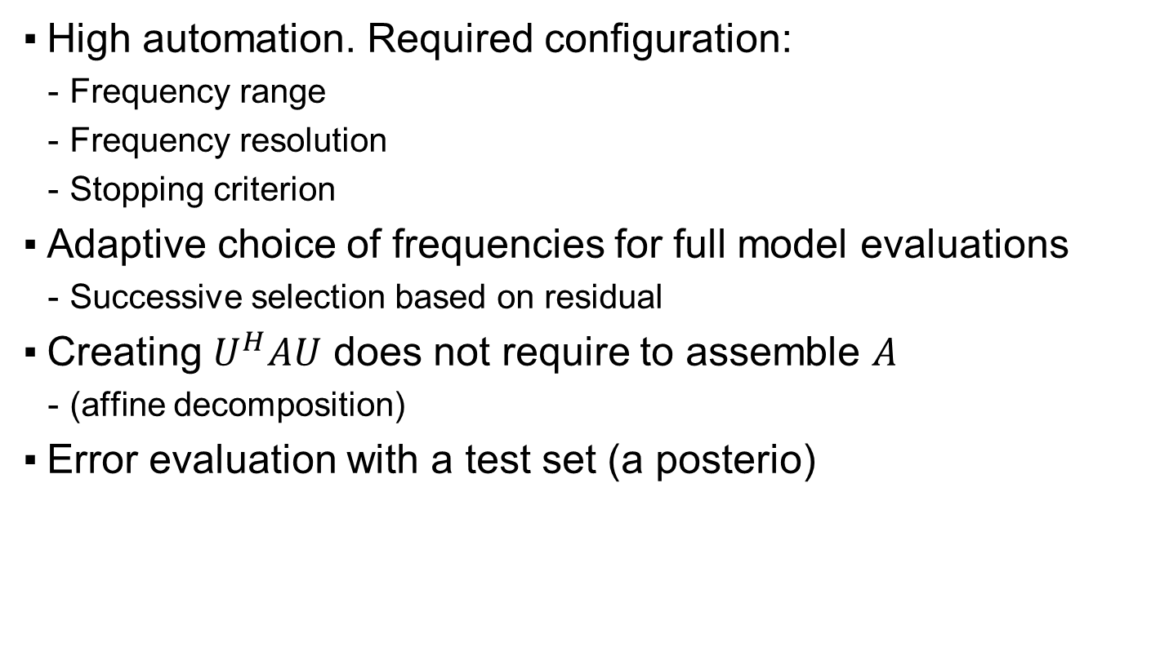
Further Features
High automation. Required configuration:
Frequency range
Frequency resolution
Stopping criterion
Adaptive choice of frequencies for full model evaluations
Successive selection based on residual
Creating $U^{H}AU$ does not require to assemble $A$
(affine decomposition)
Error evaluation with a test set (a posterio)

Slide 8
Architecture
Felis (C++)
Commands: ZeroMQ
Python
Petsc write
Custom read
HDD

Slide 9
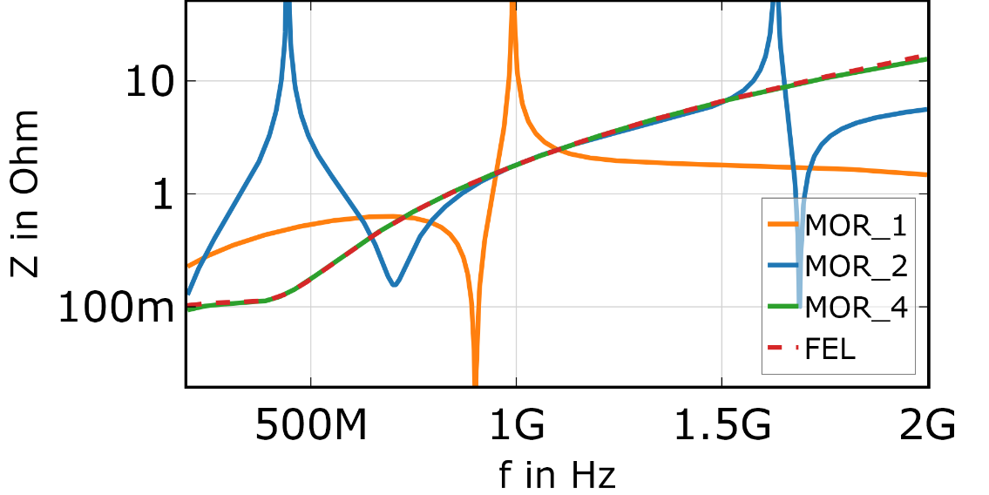
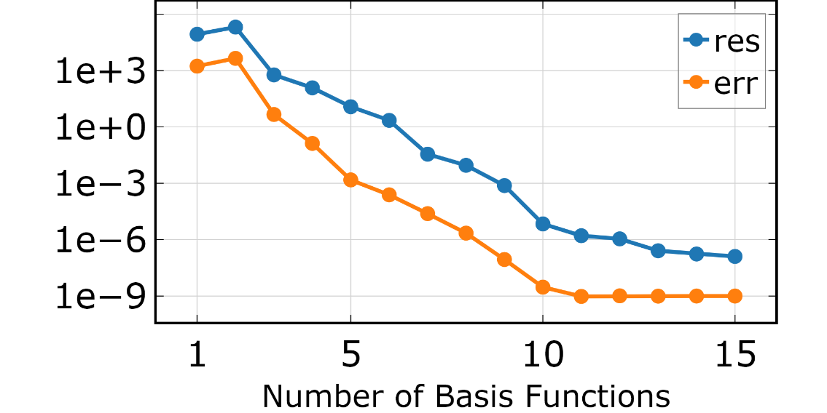
Results – Resistive Waveguide
Resistive
wall
Simulation Domain
Beam
Waveguide ports (10 TM modes)
Computational cost
4 evaluations with MOR
10…100 evaluations without MOR
Notes:
Mor Adaptive

Slide 10
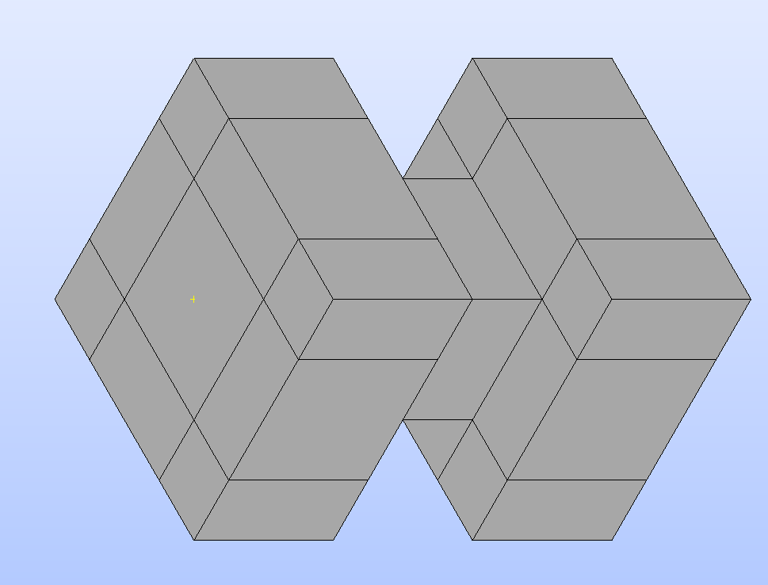
Results – WG Transition
Port
Beam
Resistive Wall
Port

Slide 11
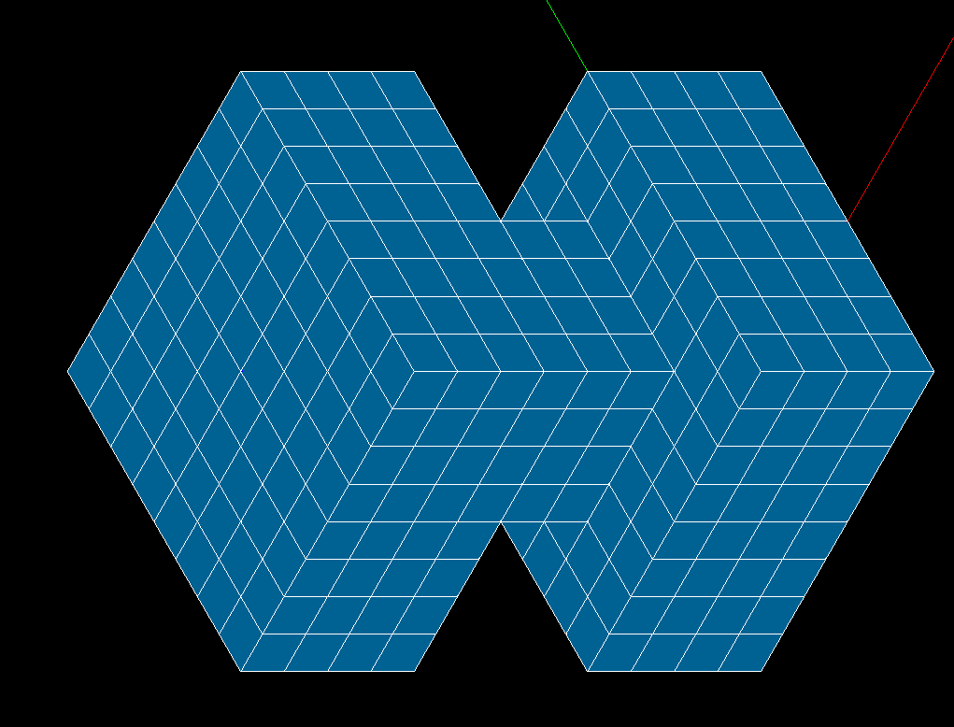
Results – WG Transition Mesh

Slide 12
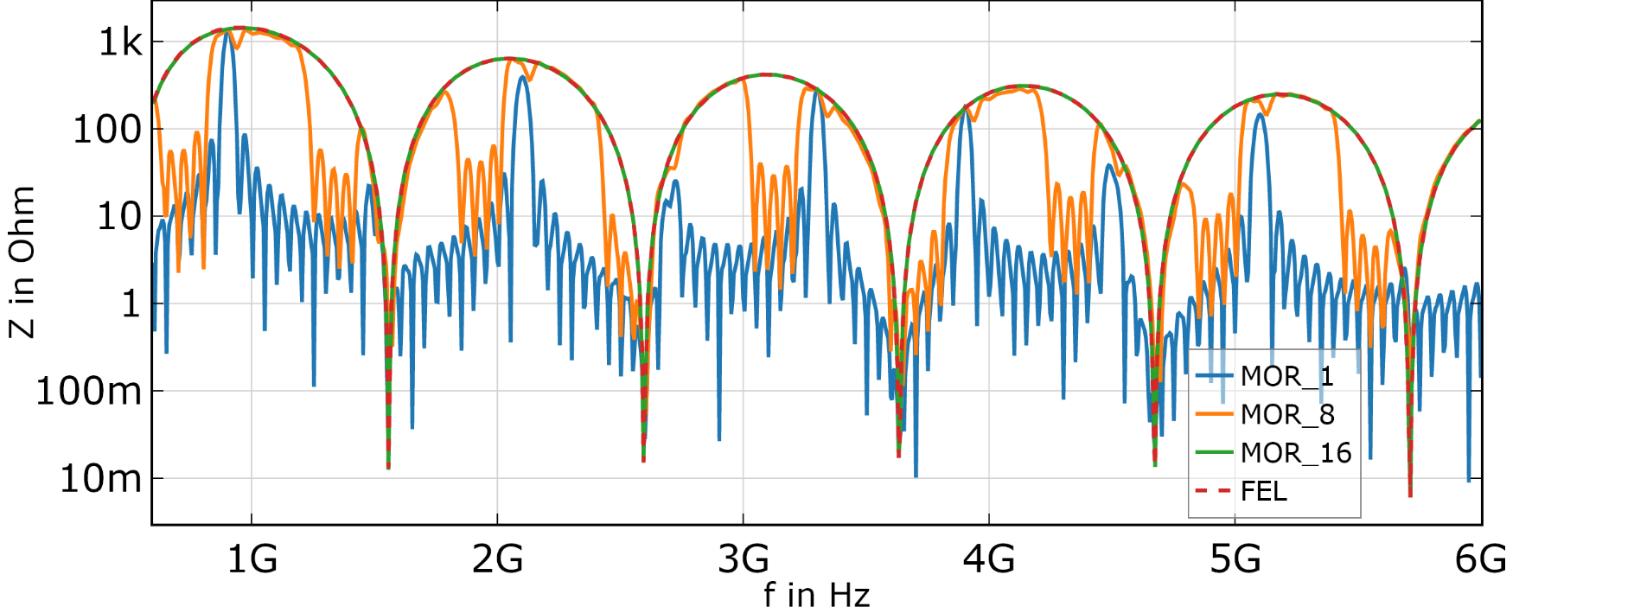
Results – WG Transition
Notes:
Mor Adaptive

Slide 13

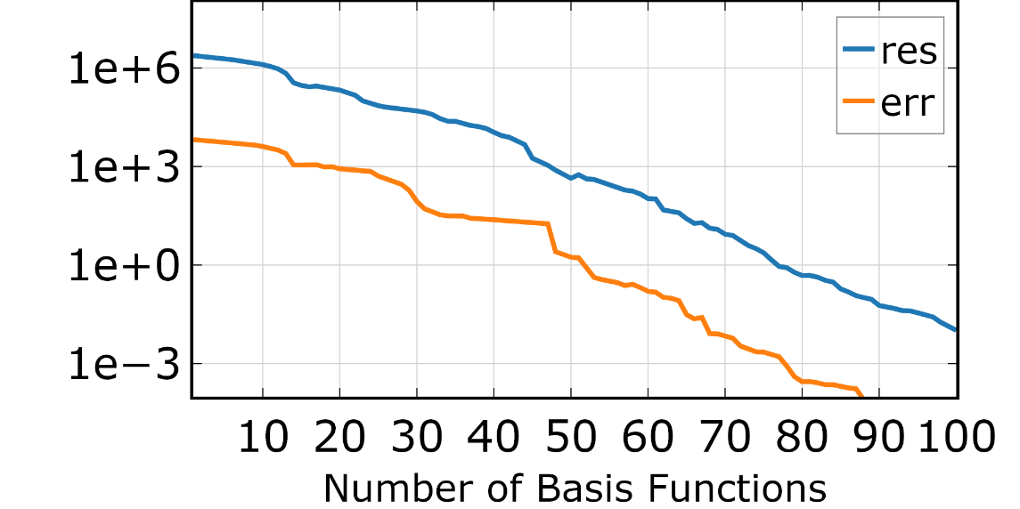
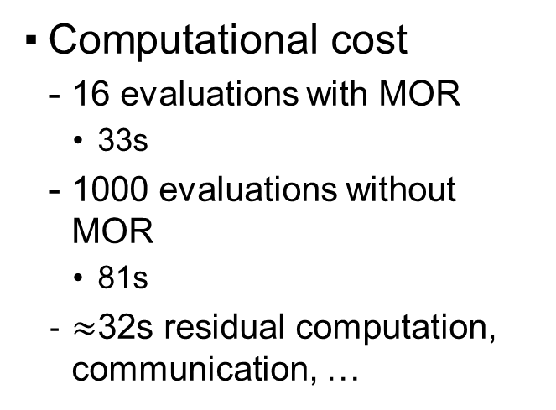
Results – WG Transition
Computational cost
16 evaluations with MOR
33s
1000 evaluations without MOR
81s
$≈$32s residual computation, communication, …
Notes:
Mor Adaptive
81s just felis
139 felis+matrix export

Slide 14
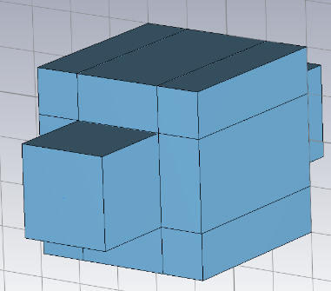
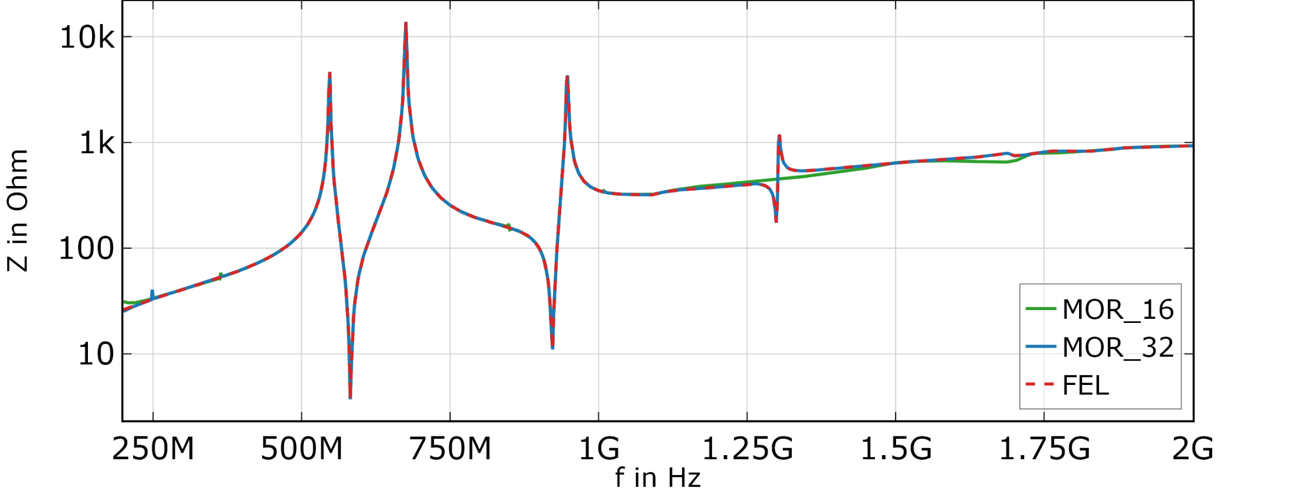
Results – Cube Cavity

Slide 15
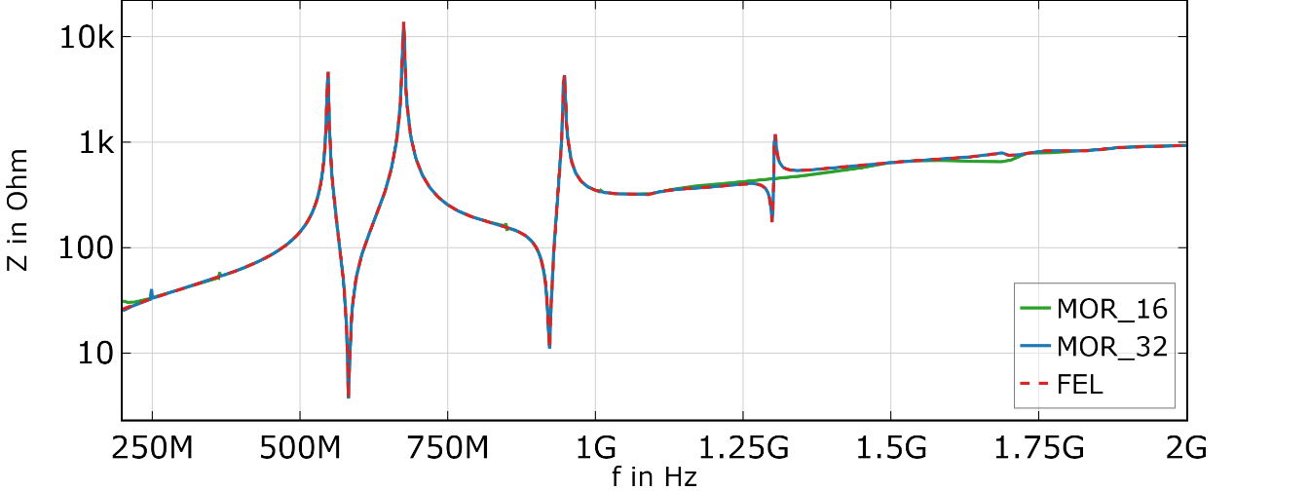
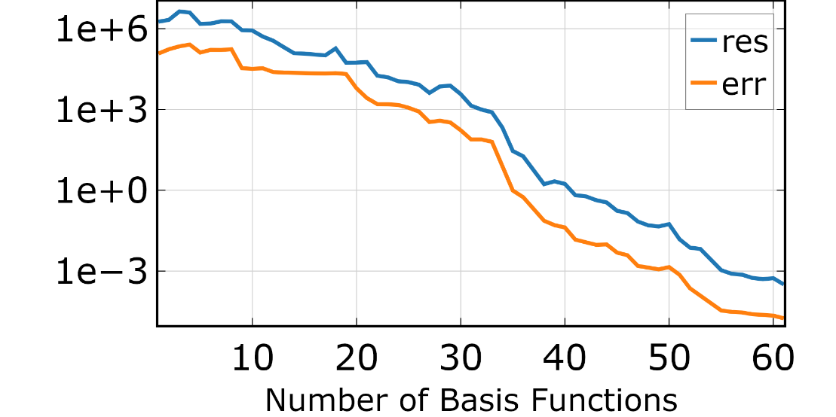
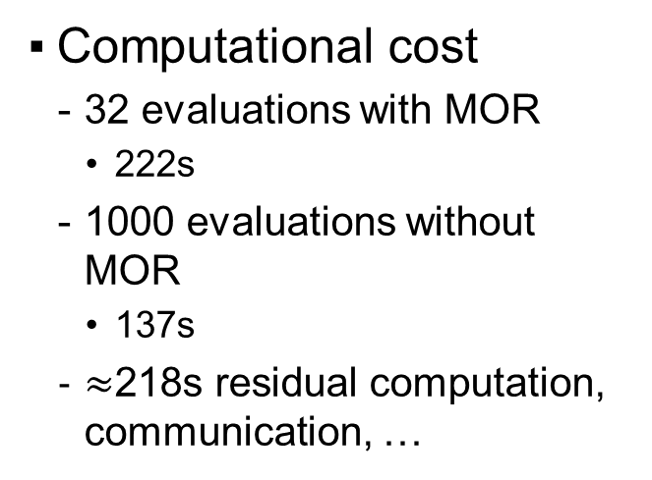
Results – Cube Cavity
Computational cost
32 evaluations with MOR
222s
1000 evaluations without MOR
137s
$≈$218s residual computation, communication, …

Slide 16
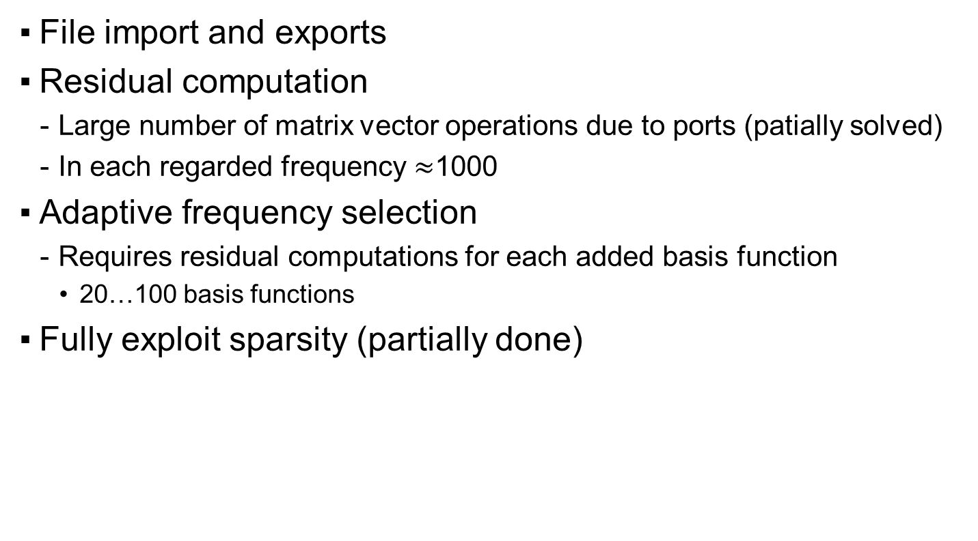
Computational overhead
File import and exports
Residual computation
Large number of matrix vector operations due to ports (patially solved)
In each regarded frequency $≈$1000
Adaptive frequency selection
Requires residual computations for each added basis function
20…100 basis functions
Fully exploit sparsity (partially done)

Slide 17
Outlook
Test with larger models
Ratio of overhead to actual solving better?
More efficient resiual estimation
Not always in every frequency (less evaluations)
Nested MOR (QR decomposition) (in progress)
Only check some DOFs (Partially done, works)
Truncation of the basis matrix (SVD)
Parallelization
Memory cost / runtime tradeoff
Implementation in C++
Large number of small matrix vector operation is slow in Python
No imports/exports

Slide 18
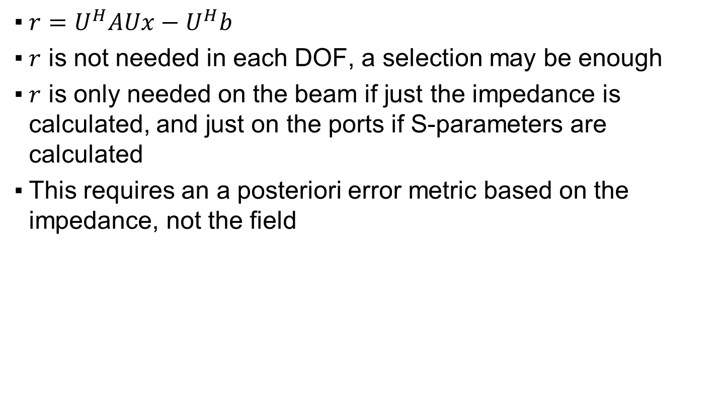
Only check some DOFs
${r=U}^{H}AUx−U^{H}b$
$r$ is not needed in each DOF, a selection may be enough
$r$ is only needed on the beam if just the impedance is calculated, and just on the ports if S-parameters are calculated
This requires an a posteriori error metric based on the impedance, not the field

Slide 20
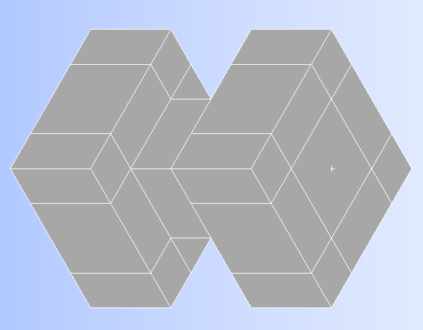
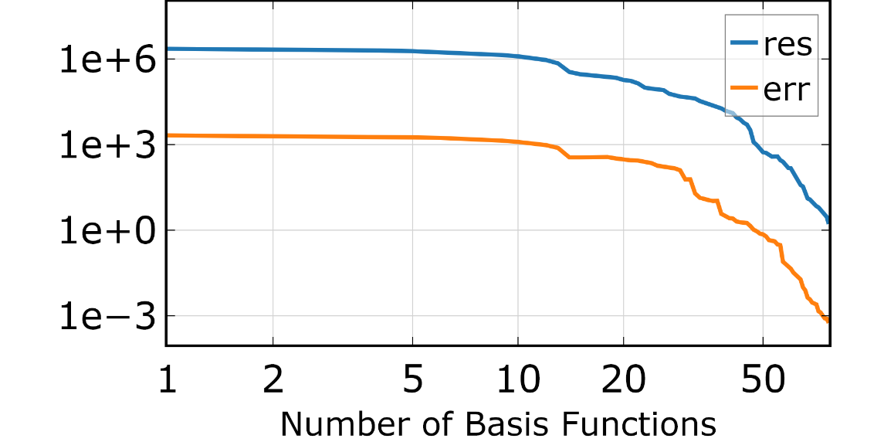
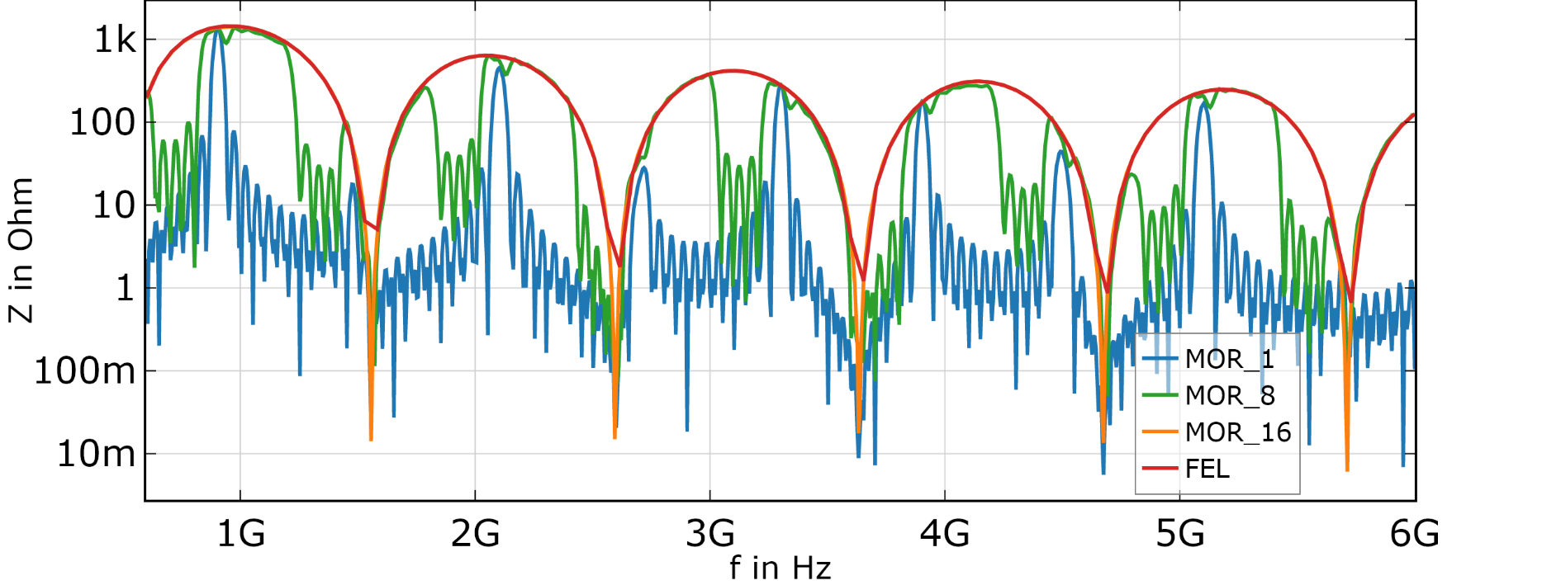
Results - Constriction
Notes:
Mor Adaptive

Slide 21
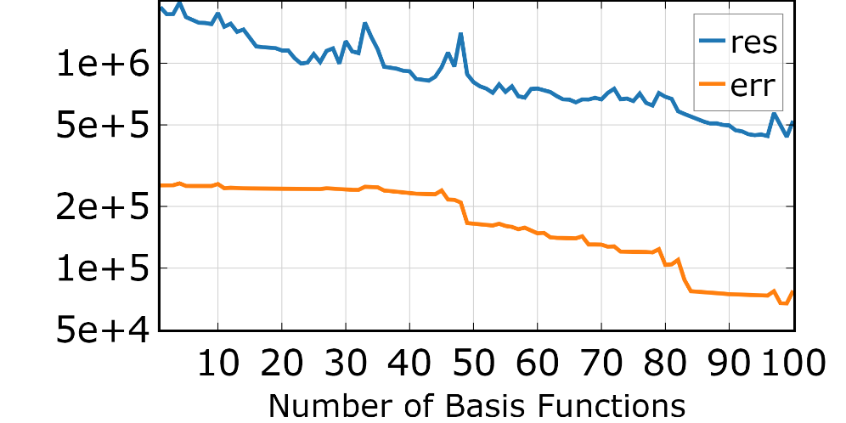
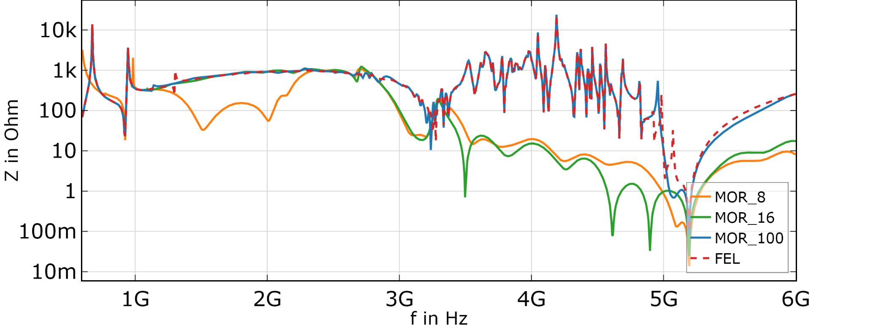
Results – Square Cavity

Slide 22
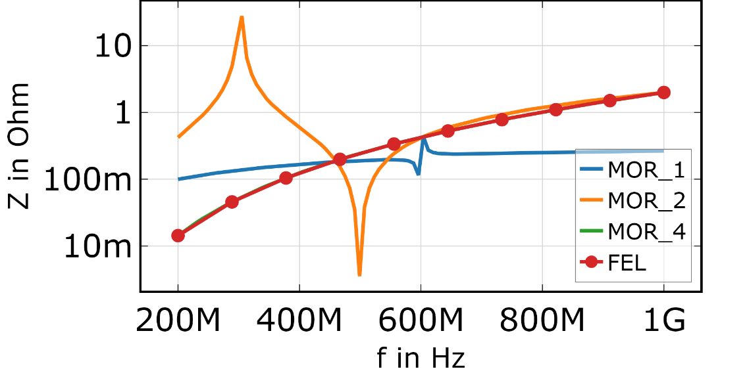
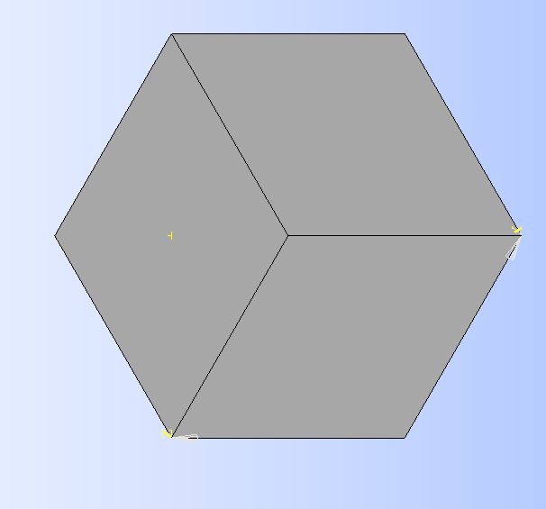
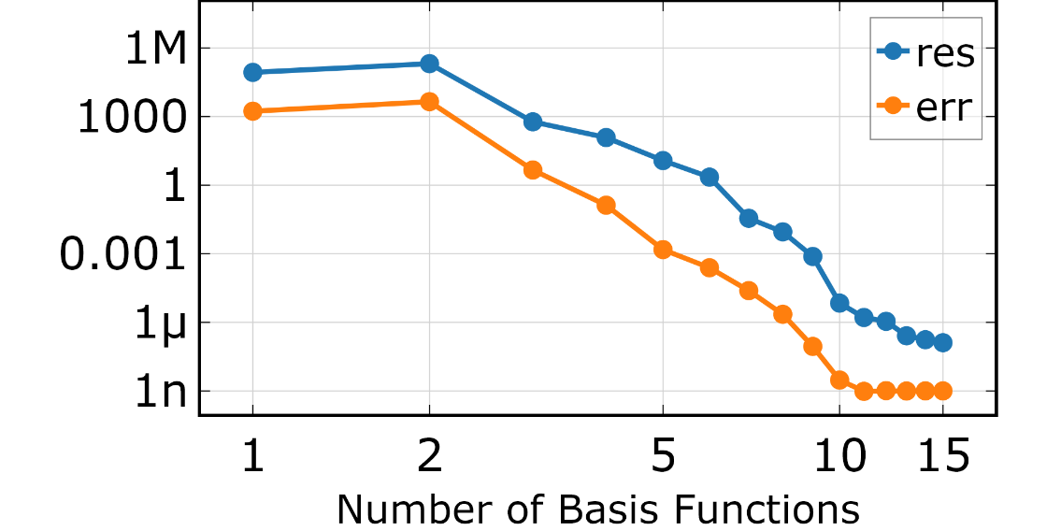
Results - Cubewire
Port
Beam
Resistive Wall
Port
Notes:
Mor Adaptive

Slide 23
Results - Cubewire
Port
Beam
Resistive Wall
Port
Computational cost
4 evaluations with MOR
10… evaluations without MOR
Notes:
Mor Adaptive

